Slide 1
Jobs and Recruitment
November 2023

Slide 2
Problem statements
The council needs a shop window that better represents the culture and benefits of working in the organisation to attract future colleagues
Under recruitment of roles, particularly in the area of Social Care, leads to a higher percentage of locum staff, impacting on staff morale and retention which further impacts on service users.

Slide 3
Goals
Test the usability of the current Jobs and Careers section
Find out what information and features are most important to users seeking employment
1
Find out if our assumptions are correct
2
Uncover opportunities to improve
3
Learn about target user’s behaviours and preferences
What?
User Interviews and survey to find out what is most important to users
Usability testing:
Finding a role in Adult Social Care role (newly qualifies, local)
Finding a role in Childrens Social Care (relocating)
Finding a new opportunity, apprenticeship or general role qualified to level 2.
How?
Semi structured User interviews lasted 45-60 minutes and covered questions relating to assumptions and problems agreed with stakeholders.
Moderated usability testing was conducted and recorded via video call. Sessions lasted for 45- 60 minutes and included a brief interview and 3 practical journey tasks.
Participants gave written consent in advance for their data to be used as part of the study
Who?
Usability testing was conducted with 6 internal recently recruited employees
Participants were recruited via HR and the Councils Customer Panel
Participants included a wide demographic and range of roles/ responsibility levels as well as.
Participants included casual job seekers as well as those purposefully searching in a shorter time frame.

Slide 4
Participants
User Interviews
Who:
8 recently recruited employees in various roles, 62% Social Care roles
Survey
Who:
40 recently recruited employees (85% 0-6 months) in a range of roles across the organisation (35% Social Care)
Usability Testing
Who:
6 Participants currently or recently looking for employment

Slide 5
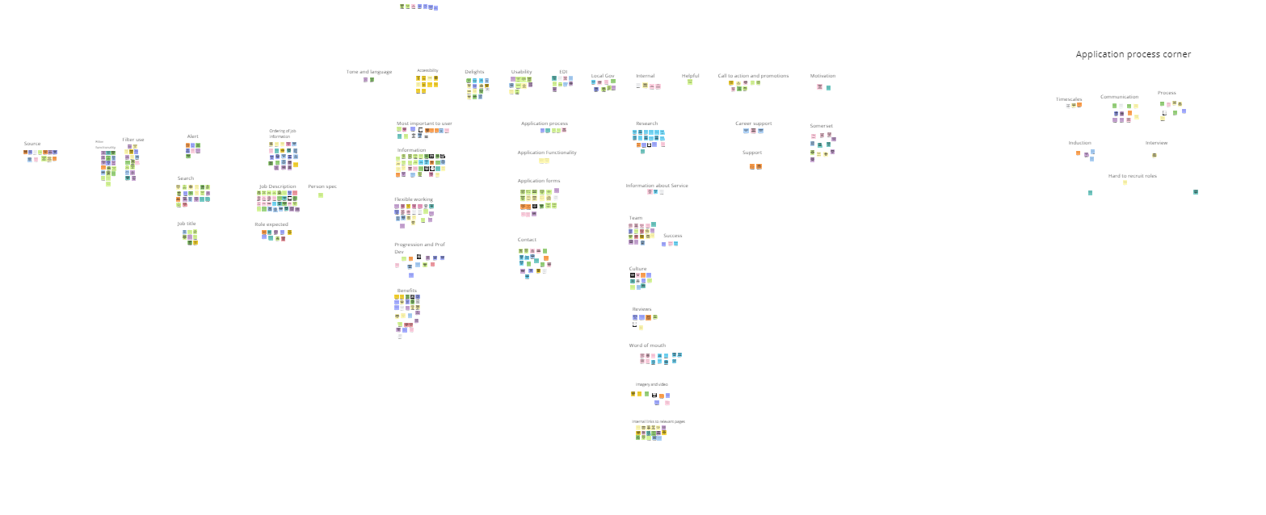
Insights were analysed and grouped into themes:

Slide 6
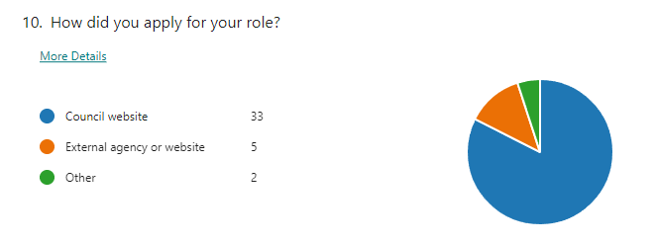
Theme
Users don’t always come directly to Somerset Council website
Users land on the specific job advert and sometimes therefore miss other information in the jobs and career section
“I don't think looked much at the website as the link from Indeed when straight to the job”
Many users come to the website from sources such as Indeed. Information can vary.
Users land on the specific job advert and expect all information to be available there

Slide 7
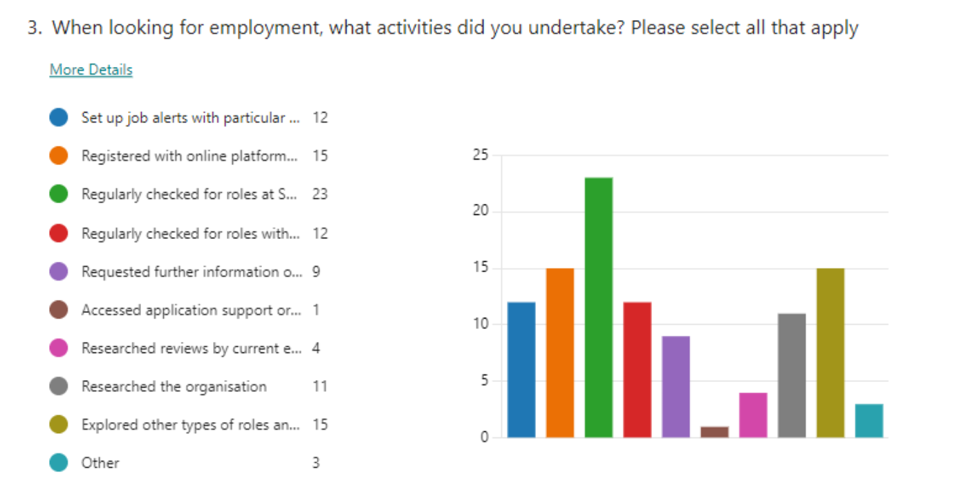
Survey insights

Slide 8
Theme
Searching for job roles is not always straight forward
Users find the number of social care jobs can get in the way of finding other roles. Alert gives all jobs
Some job roles cannot be found when filtered to the wrong department. Some roles are not service/ department specific for end user therefore hard to find
Some job titles may not appeal or make sense to users. Titles are sometimes ambiguous or inconsistent which results in users scrolling past but can also impact on progression.
It is not always clear that a role may be open to those with relevant skills and interest, and that support is available
Users want to be able to search using keywords and filter to salary or contract type (Flexible working, p/t etc)
“I think there’s lots of job titles that are a bit ambiguous and don’t sort of line up. When you are looking for jobs it does matter.”

Slide 9
Theme
Job information is not always structured in the most helpful way and can be a barrier
Users searching multiple sites find it most helpful when key contract information and a brief description are prioritised
Users want to know if the job is best fit before exploring wider organisation information, which can otherwise get in the way.
Users generally find the job descriptions are clear and as expected
Users found it was sometimes unclear what role they would be allocated and primary location when applying
Users find the day-to-day job meets their expectations and, in some cases, exceeds their expectations
Users found sometimes contract details were unclear - hybrid, flexibility, specified days

Slide 10
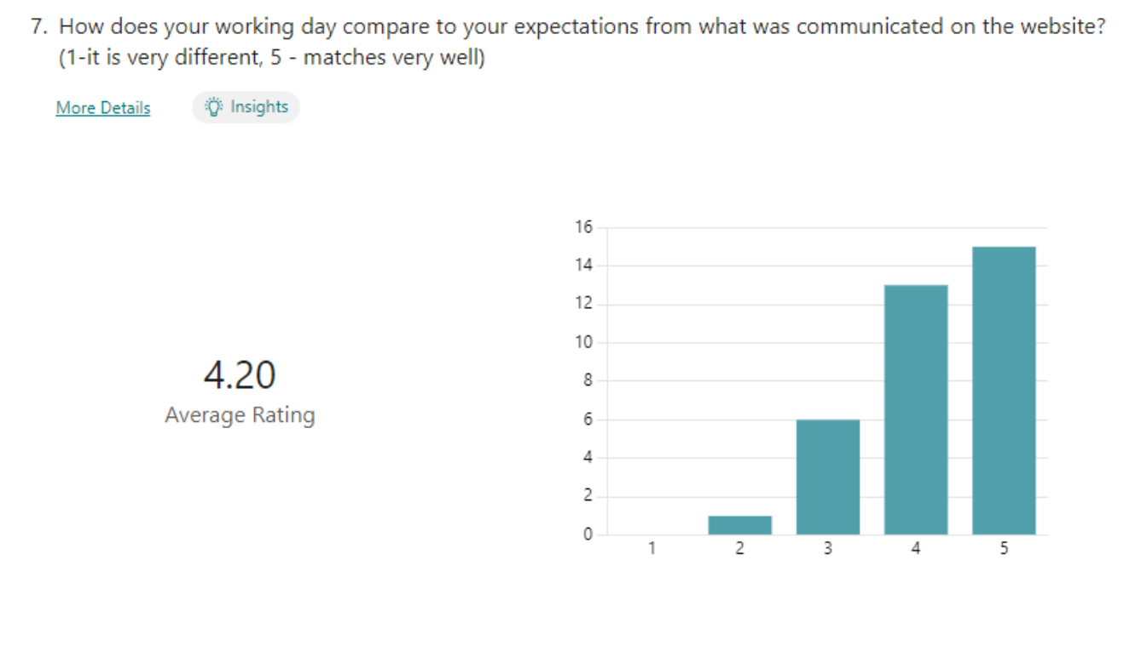
Survey insights

Slide 11
Theme
Users searching across multiple sites want to quickly find key information
Users sometimes missed staff benefits or wider organisation information
Users found the benefits most appealing – Flexible working, generous pension, perceived security, support, w/l balance but this wasn’t always clear
Information most important to users included – Flexibility/Hybrid working, core working hrs, location, level of responsibility/salary, ability to develop in role.
“Staff benefits are really something quite special and valuable and worth in real terms a lot of money.”
Users exploring multiple roles across multiple sites in short time frame, looked for key information to be prioritised that would help assess if it was worth reading on

Slide 12
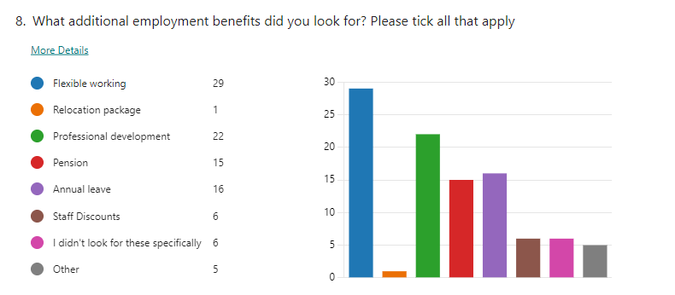
Survey insights
Working from home / Hybrid

Slide 13
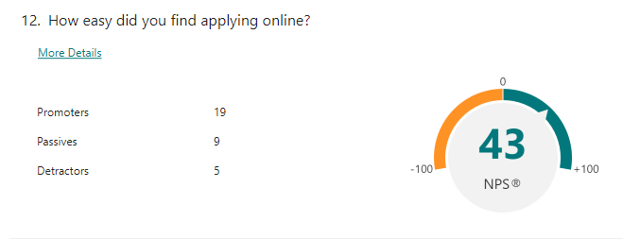
Theme
The application process information can be inconsistent
Users didn’t always know what the application process would look like, how they would be assessed and when the interviews would take place
Users found the process of applying online very straightforward
Most users like the flexibility to add CV/cover letter. Users would find the ability to save information or use it to apply to multiple roles helpful
Some users found it important to have a direct contact within the service that they could ask questions about the role
One applicant not yet fully qualified had been turned away and but secured role with other LA
Some users found that communication was not timely or consistent, and in some cases, had been offered alternative employment

Slide 14
Theme
Organisation, culture and team information is not always easy to find
Some users didn’t specifically research the organisation culture or team, but those that felt this was a high priority couldn’t always find information about their service / team
Some users looked for measures of the teams’ success
“How good they are with flexible working etc, that was the biggest thing I needed to know about the culture”
Most users did not look for staff reviews, but many relied on word of mouth. Users who did not know current employees felt that videos would be helpful for insight
"I knew nothing about the team or culture until I had accepted the job and the manager gave me a call"
Some users wanted to find contextual information about the role and team

Slide 15
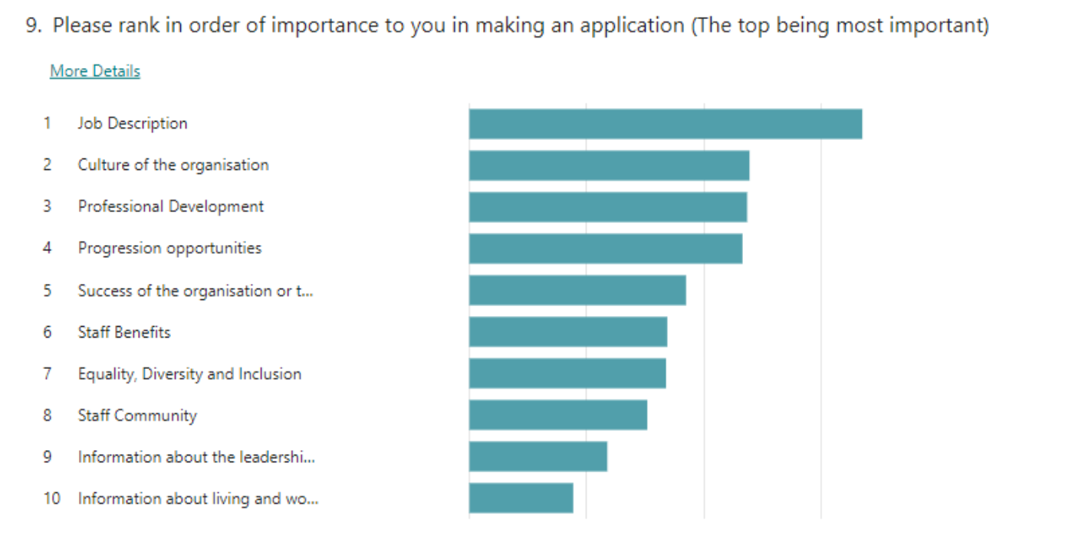
Survey insights

Slide 16
Theme
EDI information is important
Users felt that the information about Equality and Diversity was currently quite hard to find.
Users would like EDI information to be surfaced, rather than at the bottom of the 'What we can offer you page'.
Users would like to be able to find EDI information easily from each job advert.
Users felt that the location of the EDI information made it look like it was not a priority and undermined the content.
“I appreciated that the Council listed themselves as a Disability Confident employer - this gave me confidence to apply, knowing that I would not be discriminated against for my ailments”
When users found the EDI information they found it encouraging.

Slide 17
Theme
Early career and return to work support is helpful
Some users returning to work found it easier to complete an application as their CV was not up to date
Users found that it was not clear what would be offered to apprentices upon completion of the apprenticeship.
Some users overlooked roles that they perceived didn’t directly meet their experience
“When coming back to employment, instructional info - basics of Teams would be helpful”
No users had accessed application support but some felt that returning to work support and details of training/Induction would be helpful

Slide 18
Theme
Location is important but selling it is not
Users overlooked the Living in Somerset page as they didn’t perceive it as relevant information
Users did not expect the job site to sell the location and in most cases had relocated for personal reasons rather the specific role.
Users looked for relocation information on the job adverts and wanted more details about relocation offer.
“I received £7k (relocation package) - but could some of that be used as a wider incentive, like if all new recruits stayed for 2 years, receive £2k. It would help set apart and retain permanent staff.”
Most users looked for positions with bordering Local Authorities
Primary location is not always clear for users to calculate travel expenses

Slide 19
Theme
The post application / interview process can be inconsistent
Induction - SAP is problematic and some users had never been inducted. Some found it difficult understanding their place in the organisation.
Communication - Users don’t always experience timely communication or find that a key contact can be unresponsive
Timescales - Interview dates are not always known for candidates to protect time and plan or manage expectations.
Interview - There was an inconsistency in experience
Inspiration – One user reported inspirational lectures from visiting Wiltshire LA led to recruitment of high achieving graduates despite lower salary
Process - Shortlisting and interview process is not always clear
"I applied on the website. Just one criticism - I didn’t hear anything for one month. In the meantime I got offered another job. But actually I really wanted the Somerset Council job."

