Slide 1
User Research
Summary Usability Testing – LGR – Round Three – Homepage to Local Offer and Adult SC on desktop
User Researcher: Naomi Goude
User Testing: Dec 2022
Version: 1.0

Slide 2

Usability Testing
Goals
The objective was to test the build of the new website for the Unitary Authority. To make sure we build a service that users would be happy to use, find key information and complete tasks within each of the different service areas.
1
Test the user journey on the new unitary authority website to identify problems.
2
Uncover opportunities to improve
3
Learn about the target user’s behaviour and preferences
Approach
What?
The third round of testing included the Homepage, Local Offer, adult social care and a search.
The third iteration of the Dynamic Content Journey also checked with users
Test the journey to get information SEND School transport, and support for parents/carers
Test the journey to find information on equipment to support at home.
Test the journey to search for alternative section from section page inc DCJ
How?
Moderated usability testing was conducted and recorded via video call
Sessions lasted for 45- 60 minutes and included a brief interview and 3 practical journey tasks.
Tasks included mid site search
Participants gave written consent in advance for their data to be used as part of the study
Who?
Usability testing was conducted with 5 residents from the 4 districts within Somerset
Participants were recruited via the local offer parent/carer forum, YP champions and digital volunteers
Participants included a wide demographic and digital confidence level.
Two users use enlarged screen size/screen reader

Slide 3




Group One - Desktop Participants
A
18-25 years old
Windows laptop – Edge
Confident Internet user (8/9)
Uses mobile and desktop in work & home
Uses Screen Reader and increased scale- Dyslexia, visual and hearing impairments.
D
18-25 years old
Windows laptop – Edge
Less confident Internet user (7)
Uses mobile and desktop in work & home
Uses Screen Reader and Siri - Severe Dyslexia and slow processing diagnoses
B
35-54 years old
Windows laptop – Edge
Less confident Internet user (5)
Mostly uses mobile at home –mainly apps
Recently used council website for checking local offer, council tax and bins
E
35-54 years old
Windows laptop – Edge
Very unconfident internet user (0)
Severe Dyslexia and Irlen Syndrome
Uses iPad to search phone numbers but will usually have help to complete activities online
Uses phone to access online banking
C
35-54 years old
Windows laptop – Edge
Confident Internet user (10)
Slight visual impairment -Myopia and astigmatism – sensitive to light/ bright colours
Uses Council website for school applications, child minders, bin collection

Slide 4
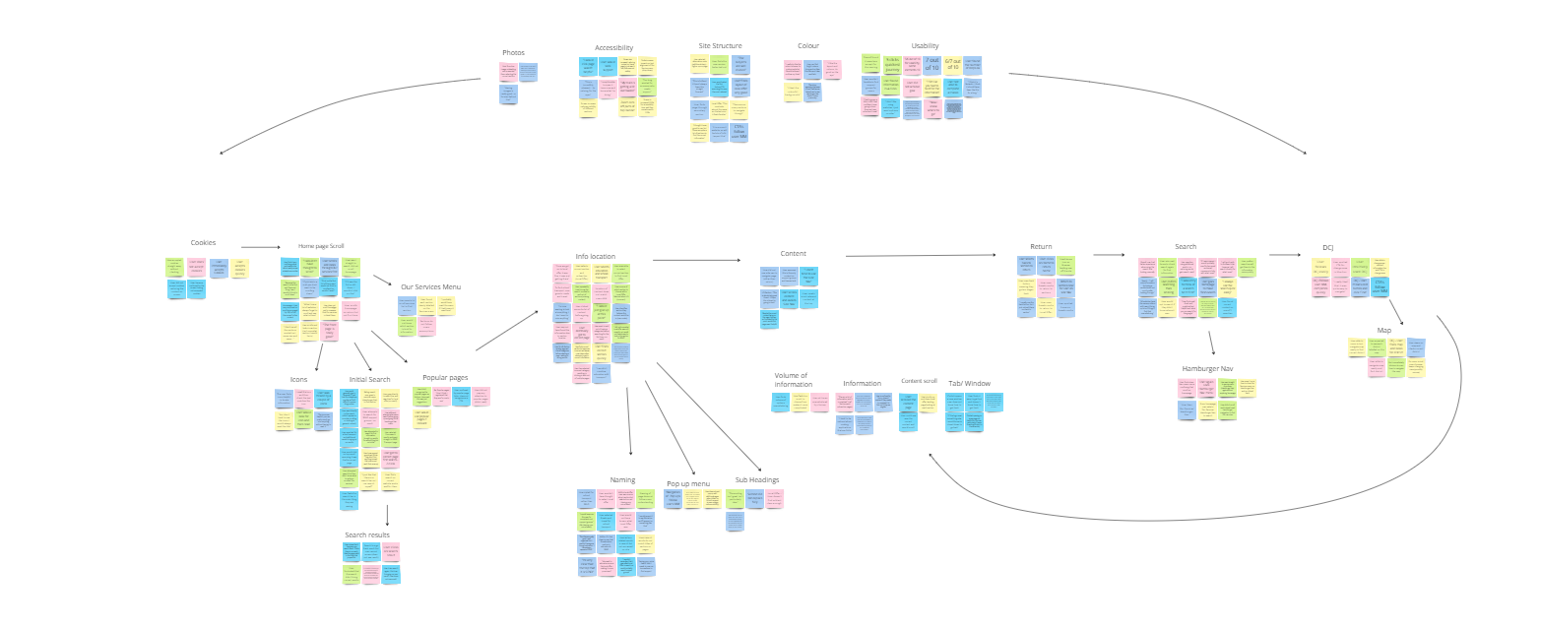
Affinity Map

Slide 5
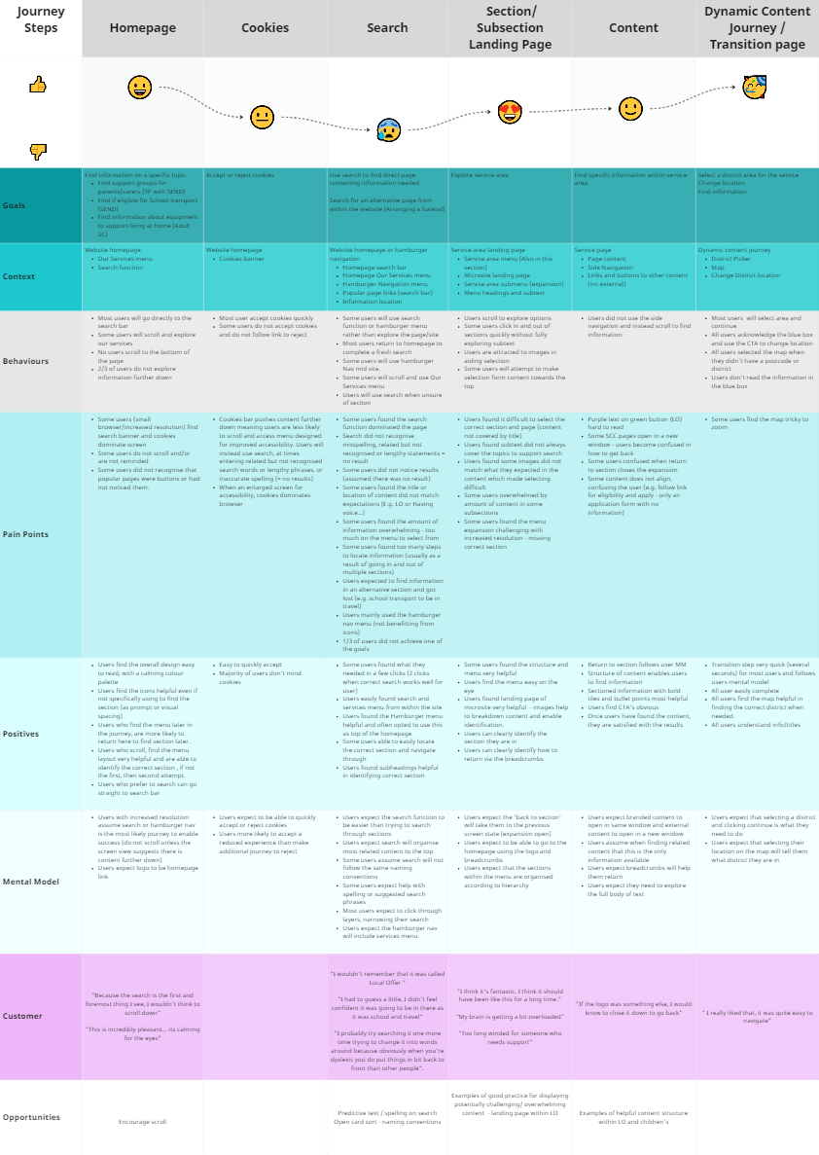
Customer Journey Map
User Goals-
Find information from the homepage –
Find out about Support for parent/carers, and eligibility for SEND school transport (Local Offer)
Find information on equipment for home (Adult Social Care)
Complete an in-site search to apply for a replacement birth certificate / explore DCJ page

