Slide 1
User Research
Summary Usability Testing – LGR –Round One – Dynamic content journey
User Researcher: Naomi Goude
User Testing: Dec 2022
Version: 1.0

Slide 2
Usability Testing Goals
The objective was to test the build of the new website for the Unitary Authority. To make sure we build a service that users would be happy to use, find key information and complete tasks within each of the different service areas.
1
Test the user journey on the new unitary authority website to identify problems.
2
Uncover opportunities to improve
3
Learn about the target user’s behaviour and preferences
Approach
What?
The first round of testing included the Dynamic Content Journey (Steps a user would take to find content that is area/district specific)
Test the area of Births, Ceremonies and Deaths
Test the area of Roads and Transport (Flood risk and sandbags)
How?
Moderated usability testing was conducted and recorded via video call
Sessions lasted for 45- 60 minutes and included a brief interview and 2 practical journey tasks.
Tasks included looking within two different district/postcode areas
Participants gave written consent in advance for their data to be used as part of the study
Who?
Usability testing was conducted with 6 residents from the 4 districts within Somerset
Participants were recruited via the Customer Panel and Digital volunteers
Participants included a wide demographic and digital confidence level.
Usability testing was also conducted with 2 Internal participants from the contact centre . 2 members of the contact centre team also observed during normal working practices.

Slide 3
Group One - External Participants
A
35 -44 years old
Lives SW&T
Confident Internet user (7/8)
Uses mobile and desktop in work & home
Recently used Council website for libraries, planning, recycling centre
D
45-64 years old
Lives South Somerset
Confident Internet user (7)
Uses mobile and desktop in work & home
Not used Council website personally
B
35 -44 years old
Lives SW&T
Confident Internet user (9)
Uses mobile and desktop in work & home
Recently used council website for moving house
E
55-64 years old
Lives Sedgemoor
Less confident Internet user (3/4)
Uses mobile and desktop in work & home
Recently used Council website for planning, refuge/recycling, last election
C
65+ years old
Lives South Somerset
Confident Internet user (9.5)
Uses mobile and desktop in work & home
Uses Council website for recycling, voluntary work – legislation
F
55-64 years old
Lives Sedgemoor
Confident Internet user (8.5)
Uses mobile and desktop in work & home
Uses Council website a lot as parish secretary and in community role.

Slide 4
Group One - Internal Participants
A
Customer Service Specialist (Contact Centre)
Adults Specific
Experienced staff member
Usability testing of DCJ
C
Customer Service Specialist (Contact Centre)
General
Experienced staff member
Observation of current working practice
B
Customer Service Specialist (Contact Centre)
General
New staff member
Usability testing of DCJ
D
Customer Service Specialist (Contact Centre)
General
New staff member
Observation of current working practice

Slide 5
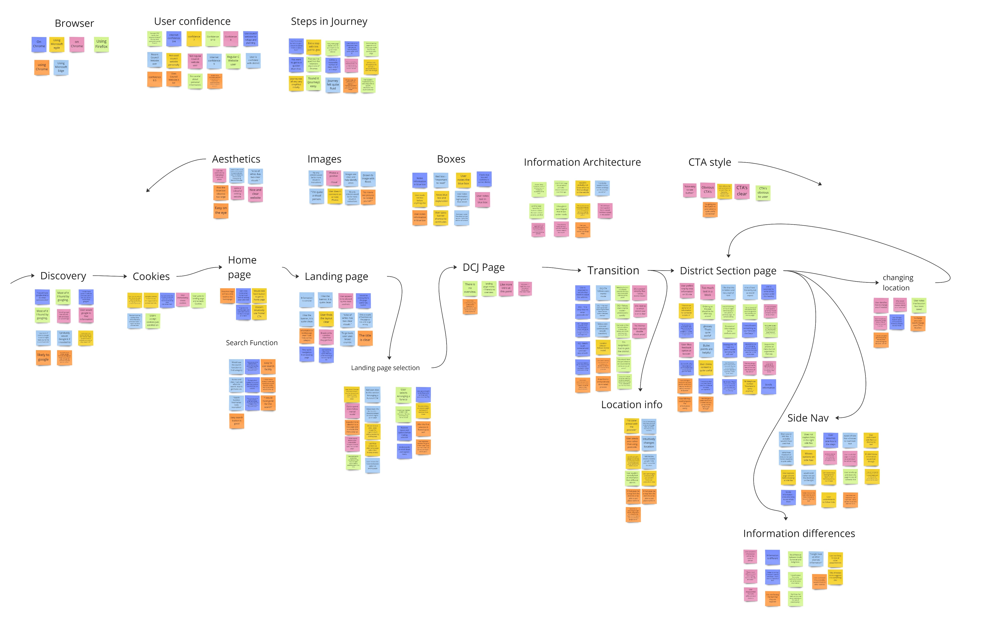
Affinity Map

Slide 6
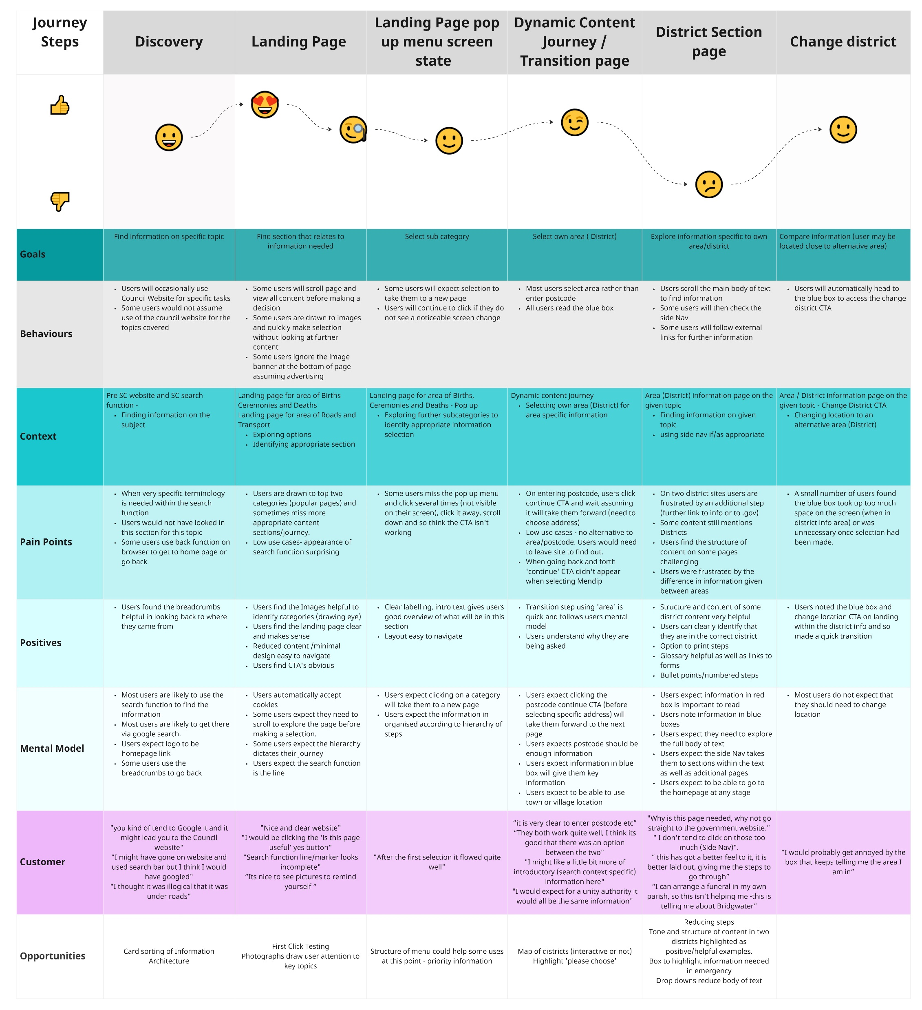
Customer Journey Map

