Slide 1
Somerset Domestic Abuse Service
June 2023

Slide 2
Project aim
The research aimed to understand the needs and requirements of our users to inform our approach to user-centred design. Through researching with users (particularly in this very sensitive context), we can create a solution that is focused on their needs to ensure an effective digital front-door to the service.
The Domestic Abuse project set out to find out how people in Somerset currently access support services for Domestic Abuse, their priority needs and aspects of accessing support that they have found difficult. We wanted to know what works well for those accessing information and support and how this could potentially be improved.
Domestic Abuse can affect anyone of any age. We wanted to know if the needs of each demographic are met and if users recognise that Domestic Abuse services are for them and feel able to access them. We also wanted to find out the experiences of those referring or signposting, what tools and resources they would find most helpful to ensure that those affected can get the help they need.
The purpose of the research was to identify how we might achieve the following vision:
Provide a clear route for people affected by domestic abuse and professionals to understand and access support services.

Slide 3
Research methods
3 x Qual/Quant Surveys
Depth interviews
Contextual interviews and pop up
2 x focus groups
Interviews with service providers

Slide 4
Participants
People affected
Survey – 54
Interviews – 10
Professionals (Signposting)
Survey – 3
Interviews – 7
Professionals (referring)
Survey – 5
Interviews – 7
Service providers
Interviews - 11
Friends/Fam/YP
Interviews – 2
Survey – 5
Focus Grp - 11

Slide 5
Theme
Theme 1 – Finding the help you need
1.1 Information / content / self help
1.2 Accessing help
1.3 Earlier help / intervention
1.4 Signposting
1.5 What SIDAS can help with / Local information
1.6 Online accessibility
1.7 Moral Support / Advocacy
1.8 Offline help (education, community, physical resources)

Slide 6
Theme
Theme 2 – Access and usability
2.1 Trust
2.2 Safety online / Safety offline
2.4 Online search
2.5 Confidence accessing help
2.6 Confidentiality
2.7 Preferred communication methods
2.8 Language and Mental load

Slide 7
Theme
Theme 3 – Is this service for me?
3.1 Meeting needs - Demographic
3.2 Men and older people
3.3 Young people / help for children
3.4 Women
3.5 Perpetrators
3.6 Friends and family
3.7 Is it Domestic Abuse?
3.8 Validation (user stories, is it for me?)

Slide 8
Theme
Theme 4 – Professionals and process
4.1 Referral process
4.2 Keeping information up to date
4.3 Information for professionals
4.4 Training needs
4.5 Joined up systems
4.6 Communication (two way)

Slide 9
Theme
Theme 5 – Service Provision - meeting needs
5.1 Customer journey
5.2 Service provision
5.3 Events
5.4 Comms campaigns
5.5 Community (forums, groups,
isolation)
5.6 Ongoing needs

Slide 10
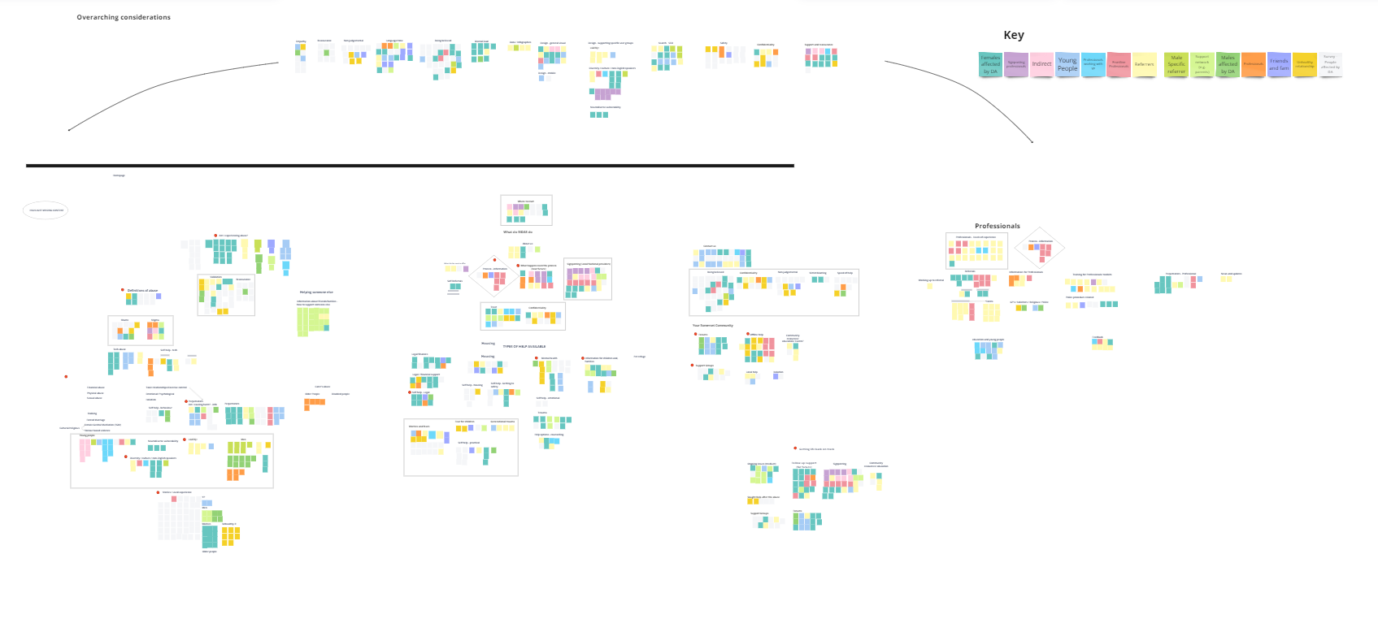

Slide 11
People affected by Domestic Abuse
The study found that the majority of participants did not access a service resolution via online methods, and this combined with a high volume of online research by participants for confirmation of abuse, suggests that the journey for users into the service can potentially be addressed through this entry point with strong positive communication about factors that influence a decision to make contact or speak with a professional.
Users need:
Demographic specific journeys that validate experience, feel relevant, enabling users to see themselves reflected in the user group with appropriate signposting for additional needs. (Theme 1 & 3)
Additional information on types of abuse to support users to recognise their own experiences in a broader range of contexts. With ‘is this domestic abuse?/ Unhealthy relationships’ the main entry point for support. (Theme 3)
For emergency help, visible contact tools and online safety features that are clear with visible working hrs, who/what/why and encouragement. (Theme 1)
User stories that reflect a broad demographic of users and quantities reflect statistics (i.e. not overly focused on women in a traditional domestic setting). (Theme 3)
To access self-help materials that can be used as a signposting to the wider services needed as part of the customers journey (Theme 1&3)
A clear and visual customer journey through the service and levels of support available. Including an explanation of the role of an IDVA. (Theme 5)
A user journey through the site that reflects the customer journey (Theme 1&5)
Materials and signposting to local resources for ongoing emotional and psychological support– For example, advice for those dealing with long term trauma. (Theme 2)
Ongoing practical guidance – for example, shared childcare with perpetrator, dealing with challenging behaviours of a child witness of abuse. (Theme 2)
For support network (friends and family) - How to recognise signs for earlier intervention and how to talk to the person affected about your concerns (Theme 3)
A common voice with explanations that can apply in a range of contexts and demographics. (Theme 2)
Positive imagery or preferably not people within main body of the site (Theme 2)
To feel local and community focused. (Theme 5)
Equality and diversity is clear and everyone is represented, but not tokenistic, and is reflected through in support provided starting with referral forms. (Theme 3)
Easy access to components which may be used across different groups (Theme 1)
The ability to search for specific topics or materials (Theme 1)
Design and tone of voice that is professional, clear, easily accessible, hopeful, safe and promotes wellbeing. (Theme 2)
Events information for physical drop-in opportunities (Theme 5)
Content that is written with consideration of mental load and accessibility (Theme 2)
An entry point for perpetrator information than is not triggering for other users (Theme 3)
Phase 2 –
Language features for translation. (Theme 1)
Options for online interactive peer/professional support (Theme 5)
Professionals log in to access up to date information on upcoming events and programme schedules such as Freedom Programme. (Theme 5)

Slide 12
Professionals
The study found that accessibility is challenging for busy, less confident or occasional referring professionals, who also needed more digestible illustrated process guides. Professionals also need processes that avoid duplication and can be completed efficiently, as well as receiving feedback for reassurance and safeguarding.
Professional users need:
A clear professional landing area with key contact information, support available to professionals and quick access to referral. (Theme 4.1)
An online referral process that will reduce duplication (appropriate sections going to the correct service in the back end) (Theme 4.1)
Low volume/occasional referrers need a toolkit of support that includes clearly laid out instruction, a simplified flow diagram of the referral process, and avoids use of unnecessary service specific professional terminology. (Theme 4.1, 4.4 & 4.7)
Support options for less confident professionals. (Theme 4)
Feedback post referral - from simple auto feedback on submission through to personalised confirmation of support. (Theme 4.8)
A clear and simplified customer flow through the service and eligibility for support. (Theme 4.3)
An up-to-date news section that communicates service updates and where reports can be communicated to professionals in a manageable categorised format (Theme 4.3)
An organised content structure that ensures nothing confidential, or potentially triggering, is not immediately visible to those straying into this area. (Theme 4.3)
Common voice and accessible language (Theme 2)
Materials to support a broad range of contexts (Theme 4.3)

Slide 13
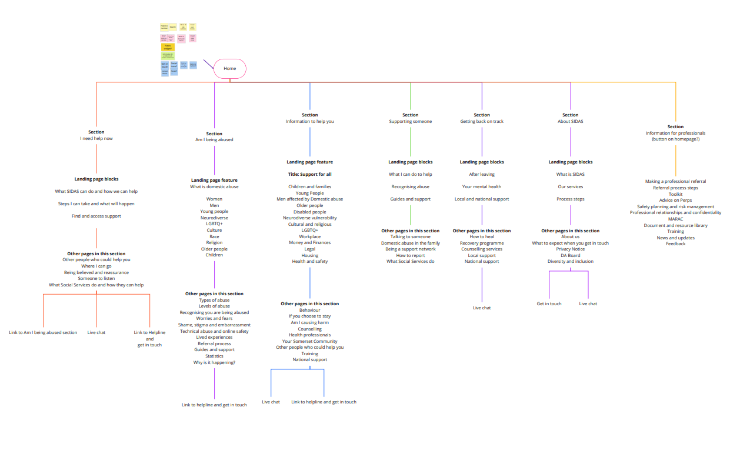

Slide 14
How Might We?
People affected by Domestic Abuse
Finding information online - Is it DA/Unhealthy relationship?
Validation / reassurance /confidence (messaging, stats, survivor stories)
Customer Journey – SIDAS (what does this look like, what will happen, what am I eligible for)
Safety (online and offline)
One stop information and signposting (local vs national)
Sensitive to varied population - male/female /YP/Older/ Perpetrator
Friends and family
Events
Professionals
Access –referral/tel
Referral Process – process and guidance
Two-way communication
Customer Journey – SIDAS (what does this look like, what will happen, eligibility)
Information and guidance
Additional resources
Events and updates

Slide 15
How Might We?
Overarching Themes
Language/tone of voice/imagery
Diversity – HBV et0c, LGBTQ+, Neuro diversity
Accessibility / Mental load
Site Maintenance - Content
Clear messaging
Other Considerations that may have web/digital solutions
Ongoing needs
Moral support and advocacy
Early help / education
Community/forums/groups/isolation
Ongoing development of self-help resources / Survivor stories
App development
Male/Perpetrator sites

